Slide 1

Pre-Submission Seminar on Web Page For Learning Web Designing
Presented By
Bhumika Balgar
Guided By
Prof. Ratnesh K.Choudhary
Department of Computer Science & Engineering
S. B. JAIN INSTITUTE OF TECHNOLOGY MANAGEMENT AND RESEARCH,NAGPUR
An Autonomous Institute, Affiliated to RTMNU, Nagpur

Slide 2
Contents
Problem Statement & Objectives
Introduction
Literature Survey
System Design: Flowchart
Use case Diagram
Developed Modules
Screenshots
Technology Used
Hardware Details
Advantages
Applications
Conclusion
Future scope
References
S. B. Jain Institute of Technology Management and Research
2

Slide 3
Problem Statement & Objectives
Problem Statement:
As we all know that due to this Covid 19 pandemic students are facing a lot of problems in their studies. The schools, colleges and other educational institutions are closed from a very long time and that is creating a huge effect in a students educational life.
But now educational system is turning students towards online methods of teaching through the means of various online platforms. But now a days students not only need the bookish knowledge but also skills.
Objectives:
To give them an online platform for skill development.
To encourage students to learn something creative.
To provide them a platform to learn new things.
To provide them a base for gaining new skills and knowledge.
S. B. Jain Institute of Technology Management and research
3

Slide 4
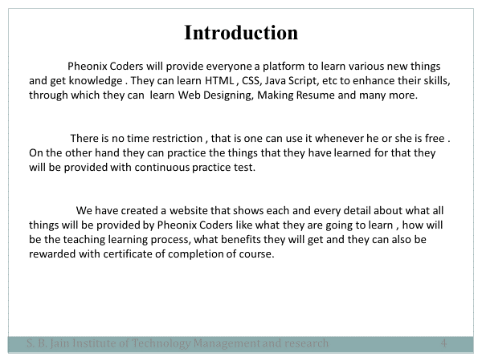

Slide 5
Literature Survey
Websites
Reviews
Coding Classes is a range of online coding courses that make coding accessible to kids & teenagers. Multiple student can make projects through the help of that platform.
Coding Classes-For Young Minds –
Coding Learning Platform
2. Codecademy
Codecademy is a platform that teaches you HTML in tiny bites. The screen is split into two sides, with one that shows the effects your coding has on an HTML file. Everything is automated and marked, so it’s easy to progress through their curriculum.

Slide 6
System Design: Flowchart
H
J
Home Page
hH
A
s
kjhg
Home
About
Themes
Contact Us
b
Technology
Information
Introduction
hI
h
i
Content
fh
Sign Up
j
j
Submit
Web Designing
Login
HLbh
Support Us
j
S. B. Jain Institute of Technology Management and research
6

Slide 7
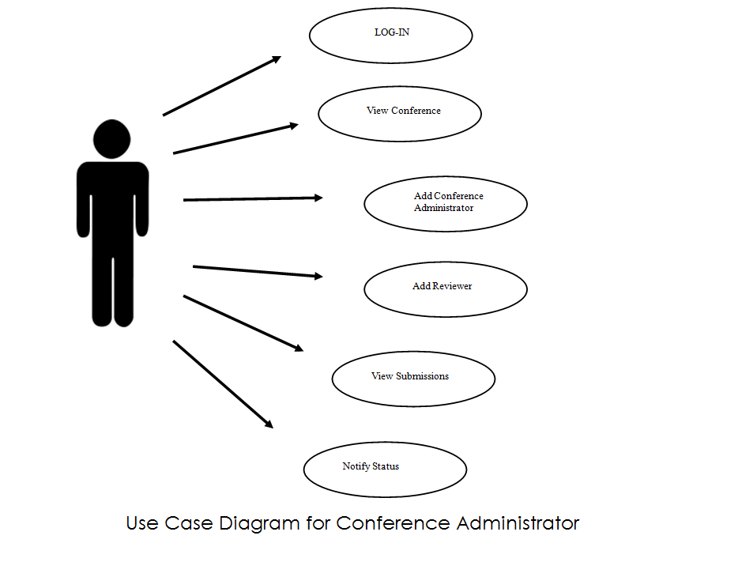
USE CASE DIAGRAM
Home
Sign Up
Login
About
Themes
Contact Us

Slide 8
Developed Modules
Home Page Module:
In this module we have created Sign Up area and Login Area
through which one can either sign-up to the course or login to the web page. With that we have given the basic information about the web page.
We have also added the path to the about themes and contact us page.
Contact Us Module:
Through this module one can add his/her details like name, Email Address , what type of query it is , like is it technical , web based or some login query. One can also elaborate the query and submit it.

Slide 9
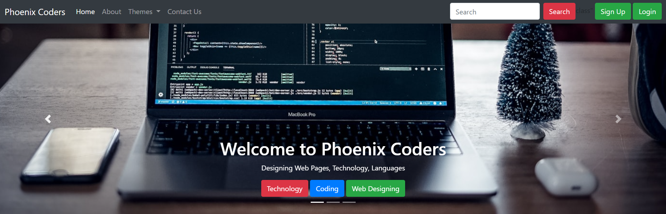
Screen Shots
Home Page
S. B. Jain Institute of Technology Management and research
9

Slide 10
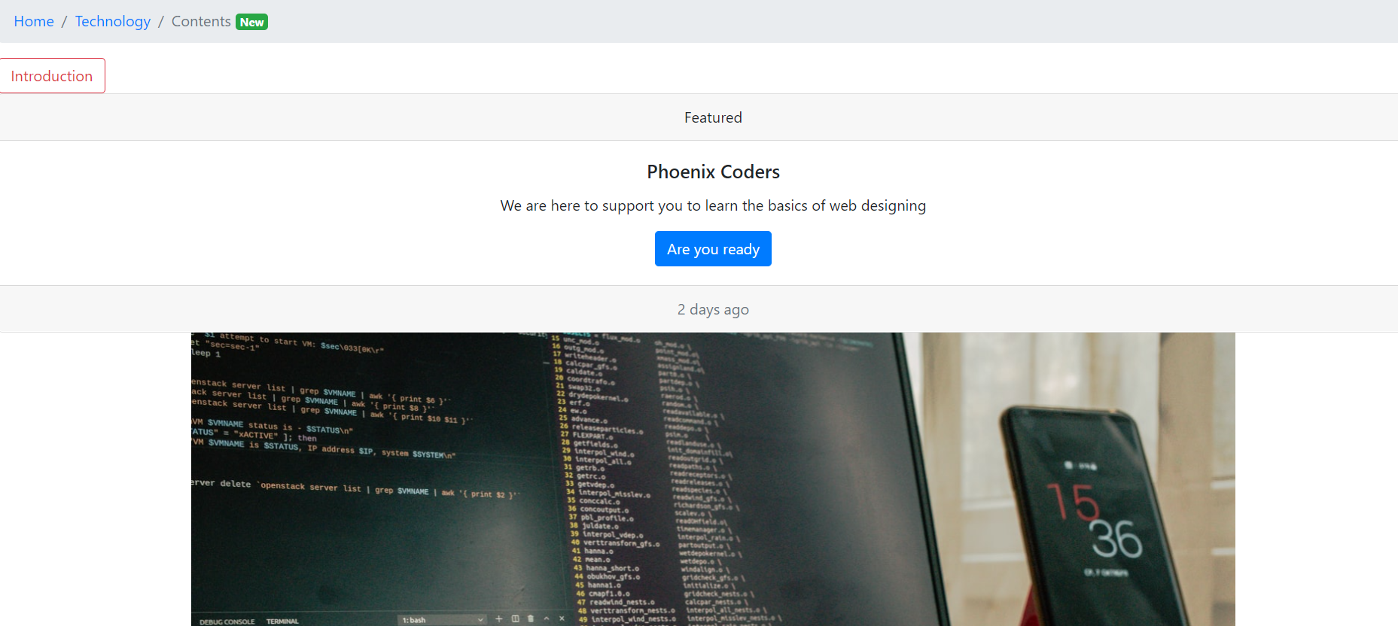
Screen Shots

Slide 11
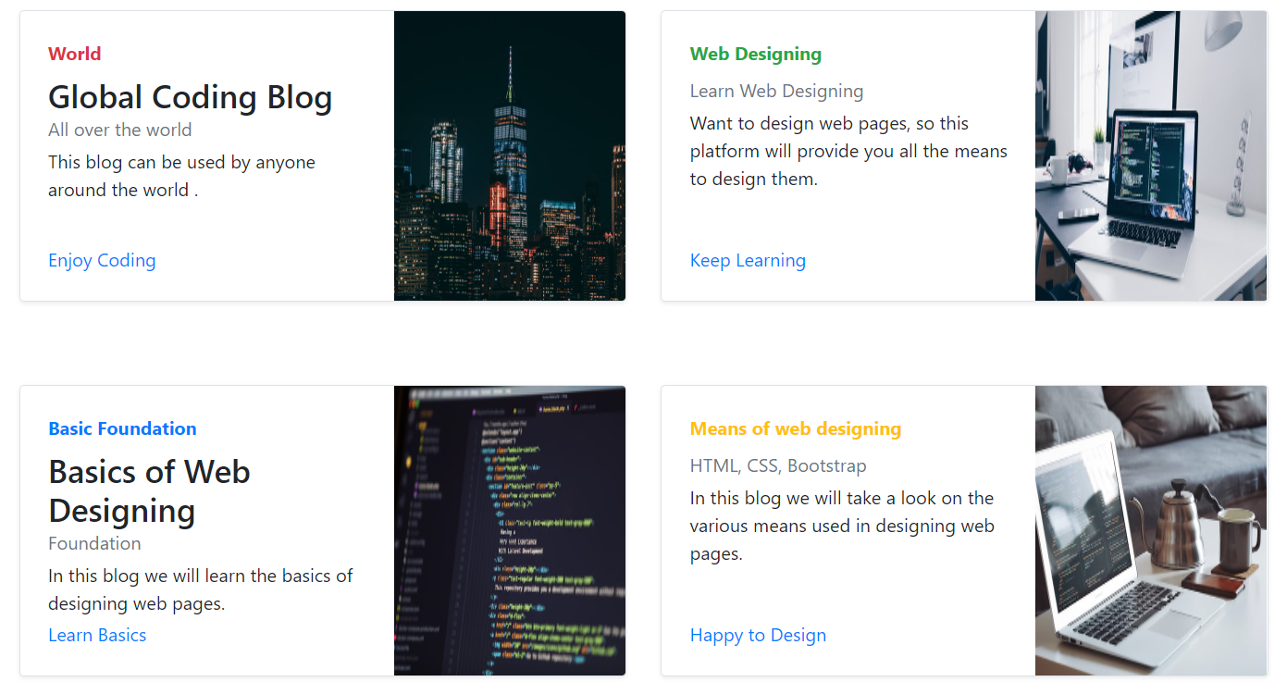
Screen Shots

Slide 12
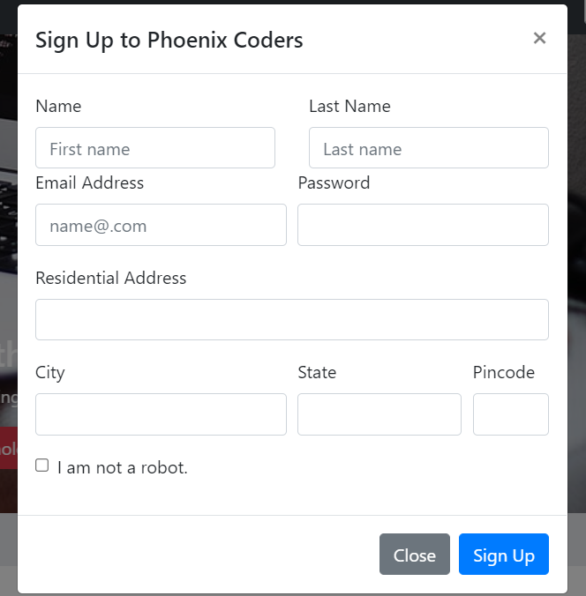
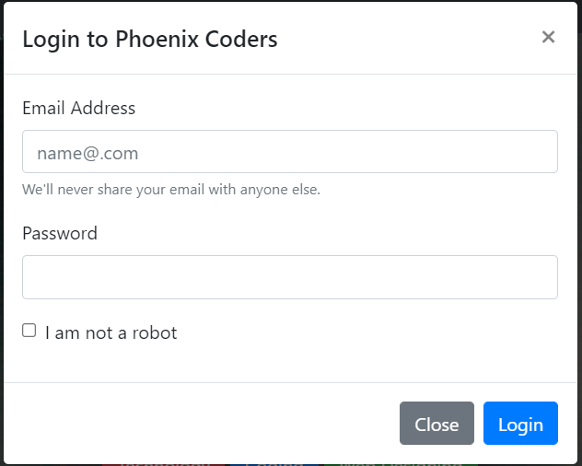
Screen Shots

Slide 13
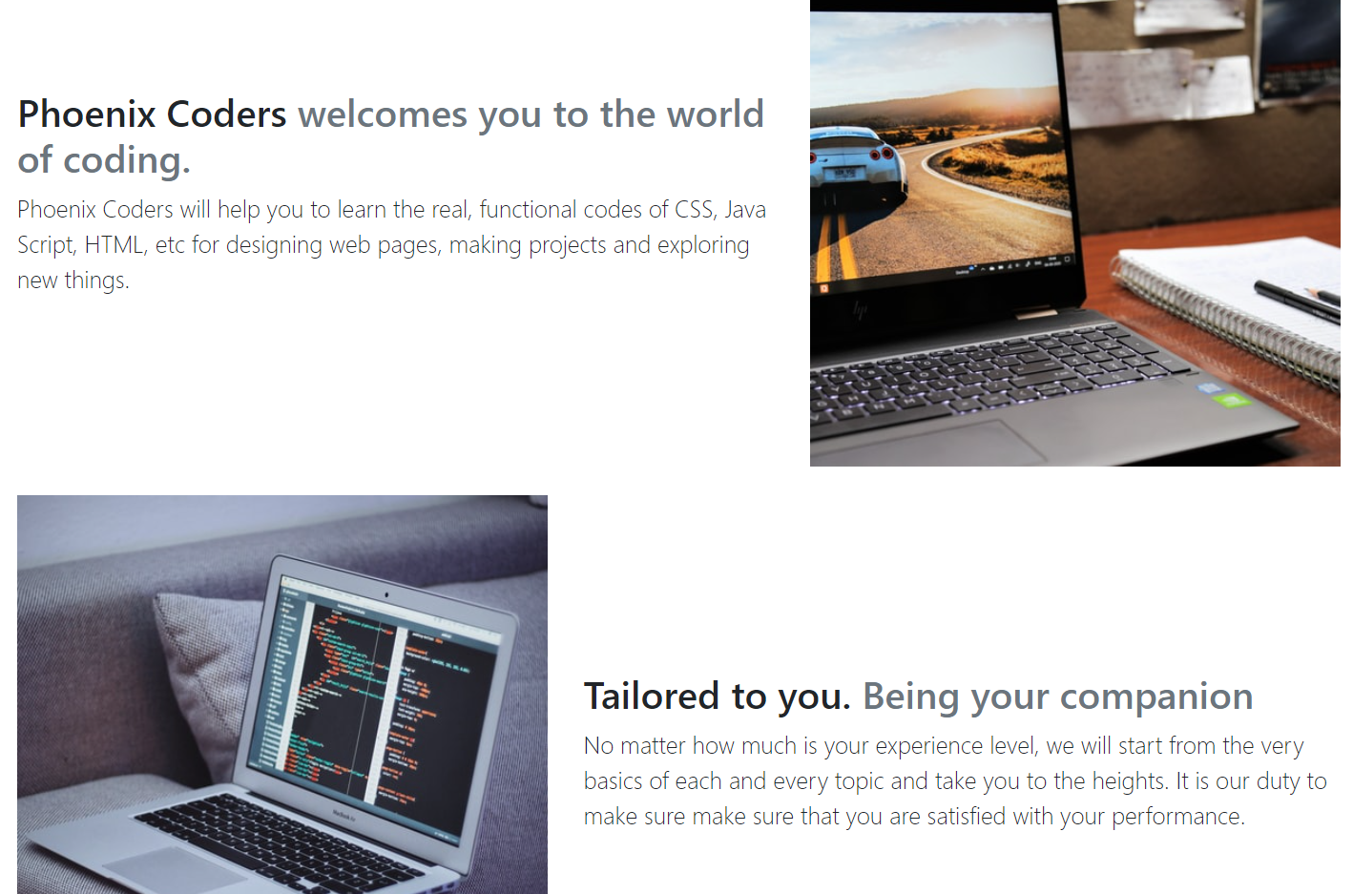
Screen Shots
About Page

Slide 14
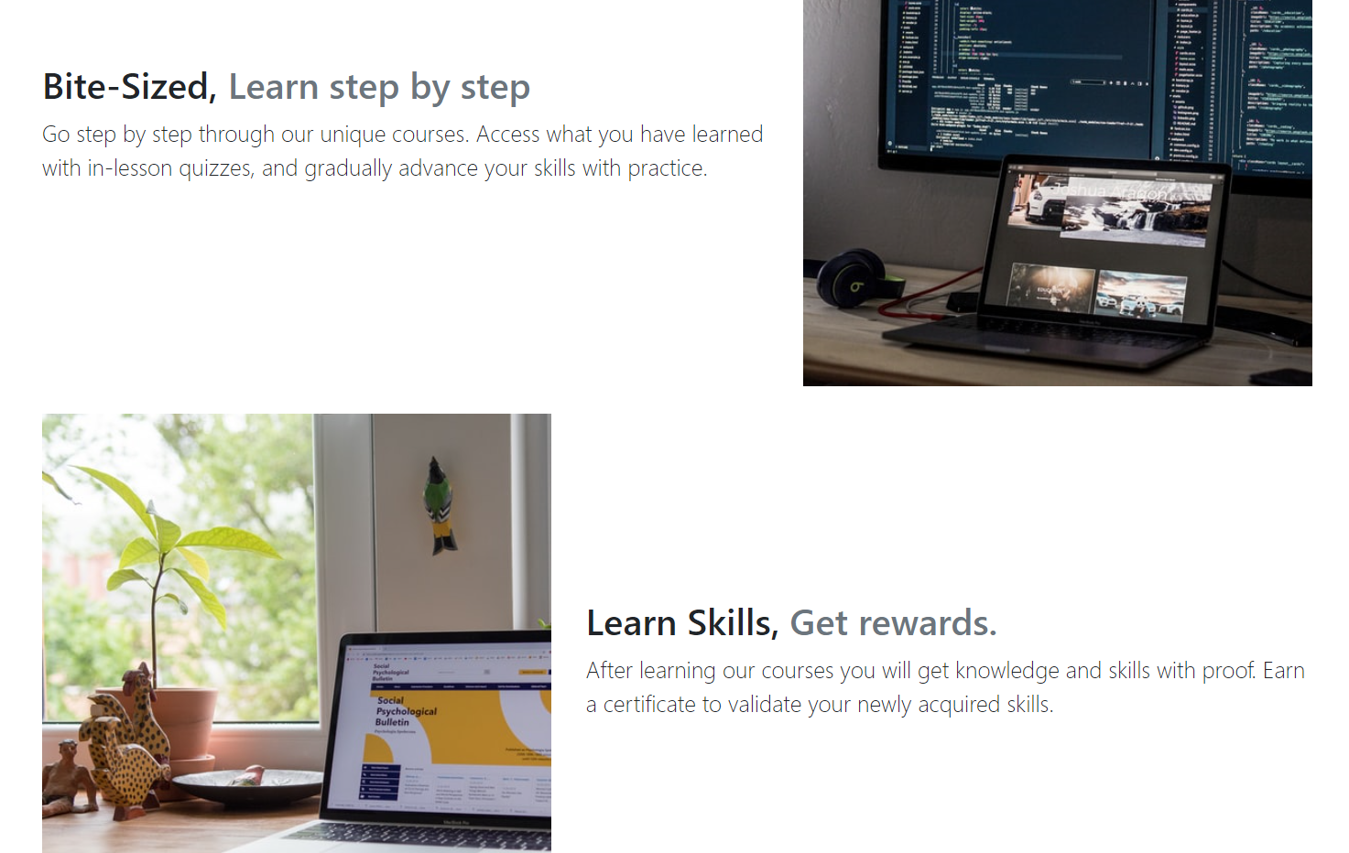
Screen Shots

Slide 15
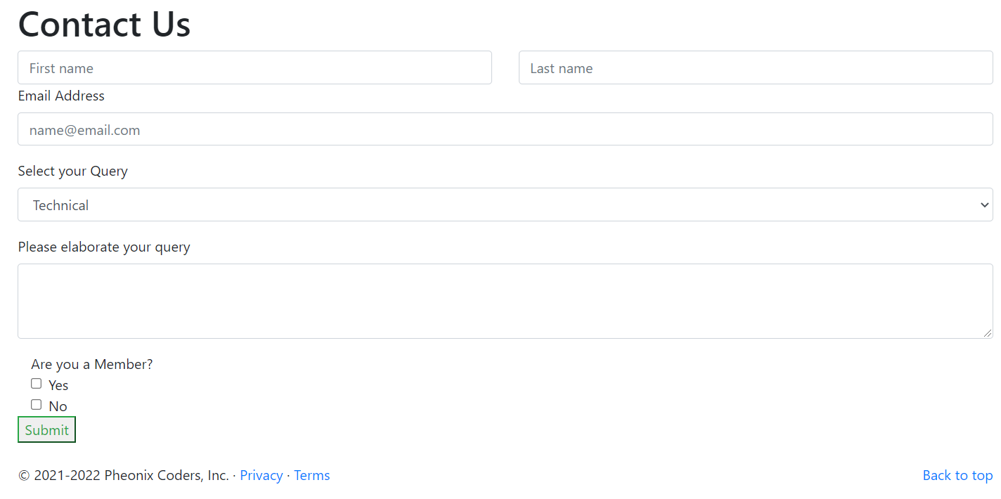
Screen Shots
Contact Us Page

Slide 16
Technology Used
Front End:
CSS , HTML
IDE:
Visual Studio Code
Website Designed:
Phoenix Coders
S. B. Jain Institute of Technology Management and research
16

Slide 17
Hardware Details
List the names of hardware used in your project:
Hard Disk
Random Access Memory
High Processing Speed
Large Storage Capacity
S. B. Jain Institute of Technology Management and research
17

Slide 18
Advantages
CSS plays an important role, by using CSS you simply got to specify a repeated style for element once & use it multiple times as because CSS will automatically apply the required styles.
The main advantage of CSS is that style is applied consistently across variety of sites. One instruction can control several areas which is advantageous.
HTML is that it is easy to code even for novice programmers.
HTML also allows the utilization of templates, which makes designing a webpage easy.
Very useful for beginners in web designing field.
S. B. Jain Institute of Technology Management and research
18

Slide 19
Applications
HTML provides the basic structure of sites , which is enhanced and modify by other technologies like CSS and Java Script.
HTML is heavily used for creating pages that are displayed on the world wide web. Every page contains a set of HTML tags, including hyperlinks which are used for connecting to other pages.
CSS helps us to control the text color, font style, the spacing between paragraphs, sizing of columns, layout designs, and many more. It is independent of HTML, and we can use it with any XML-based markup language.
CSS is used to control presentation , formatting , and layout.
Java Script is used to control the behavior of different elements.

Slide 20
Conclusion
We have successfully designed a web pages ‘Phoenix Coders’ that provides everyone a platform to learn HTML , CSS , etc. That helps to develop skills like Web Designing.
In that website we have provided the complete information about
the things that one can learn , what will be the benefits of enrolling for it , and how will be the teaching learning process.
From that website they can sign-up and login and if they have any sort of problem they can also use the Contact us portal.
S. B. Jain Institute of Technology Management and research
20

Slide 21
Future Scope
HTML , CSS and Java Script is widely used in todays world , and it
also has a great future. Everyone needs to learn this to develop their skills .
In future it will play a very vital role in each and every sector whether it
Educational or Professional.
S. B. Jain Institute of Technology Management and research
21

Slide 22
REFERENCES
https://www.javatpoint.com/what-are-the-uses-of-css
https://www.geeksforgeeks.org/advantages-and-disadvantages-of-css/
https://learnitanytime.com/6374/what-are-the-advantages-and-disadvantages-of-cascading-style-sheets-css/
https://getbootstrap.com/docs/4.4/getting-started/introduction/
https://getbootstrap.com/docs/4.4/getting-started/introduction/

Slide 23
Thank You

